Slide 1

NORTH STAR WORKSHOP
Flutter People OS
A future people workflow for a federated, global, regulated company where employees ask in channel and HR teams supervise orchestration.
One people layer. Many local realities.
Notes:
Open by framing Flutter as a company that needs one people operating layer without flattening local brand and market differences.
[Sources]
- Flutter official site, Our Business: https://flutter.com/our-business/
- Conceptual north-star framing for the Flutter people workflow workshop.
- Interactive Flutter People OS prototype created in this workspace to illustrate channels, orchestration, and supervision.

Slide 2

WHY NOW
02 / 07
Why Flutter needs a different people workflow
A federated, multi-brand, multi-market company cannot keep scaling people work through tickets, PDFs, and manual handoffs.
Federated by design
Local employment logic
Shared capability pressure
Flutter runs a global
portfolio with local brands
and operating units. People
workflows need one control
layer without removing local
autonomy.
Contracts, policies, payroll
context, and approvals
change by market, entity,
worker type, and brand.
Knowledge, analytics, shared
services, and HR tech need
to coordinate work across
the group instead of
restarting context in every
queue.
Notes:
Anchor this in Flutter's federated model and global footprint. The problem is not just volume; it is variation plus handoffs.
[Sources]
- Flutter official site, Our Business: https://flutter.com/our-business/
- Flutter official site, Hyderabad Global Capability Centre: https://careers.flutter.com/our-locations/hyderabad/
- Conceptual north-star framing for the Flutter people workflow workshop.

Slide 3

EMPLOYEE DAY
03 / 07
Ideal employee day
An employee should ask one question in natural language and receive the right answer, source, and next action for their exact Flutter context.
Ask in channel
Get the right answer
Start the workflow
Employees use web, WhatsApp,
or Telegram to ask about
policies, travel, leave,
mobility, onboarding, or
internal processes.
The system resolves brand,
country, contract type,
office, role, and manager
context before it answers.
Instead of sending a
document link only, the
assistant can launch the
request, notify the right
person, and track progress.
Notes:
This is the employee promise: less searching, less waiting, fewer tickets, more clarity and action.
[Sources]
- Flutter official site, Our Business: https://flutter.com/our-business/
- Conceptual north-star framing for the Flutter people workflow workshop.
- Interactive Flutter People OS prototype created in this workspace to illustrate channels, orchestration, and supervision.

Slide 4
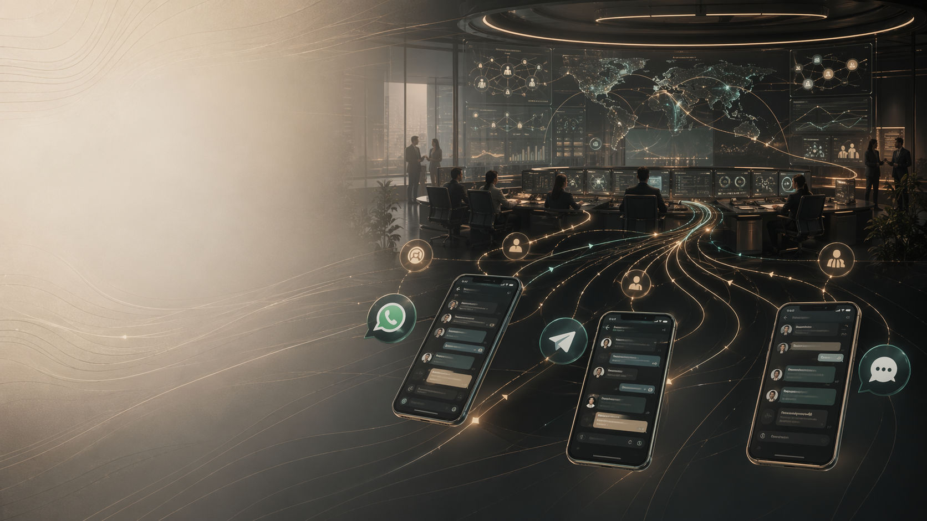
PEOPLE TEAM DAY
04 / 07
Ideal recruiting and contracts day
Hiring teams should move from role need to compliant contract through one supervised run instead of separate systems and spreadsheets.
Role intake to job architecture
Candidate flow to offer
Offer to contract
A hiring manager states the
need once. The system
proposes role family, level,
market fit, and approval
path.
Recruiting sees one live
operating view across
sourcing, interview pacing,
approvals, and package
creation.
Once the package is
approved, the right local
contract template, clauses,
entity, and signature flow
are assembled automatically.
Notes:
This is the employer-side promise: more speed and quality with clearer human intervention points.
[Sources]
- Flutter official site, Our Business: https://flutter.com/our-business/
- Conceptual north-star framing for the Flutter people workflow workshop.
- Interactive Flutter People OS prototype created in this workspace to illustrate channels, orchestration, and supervision.

Slide 5
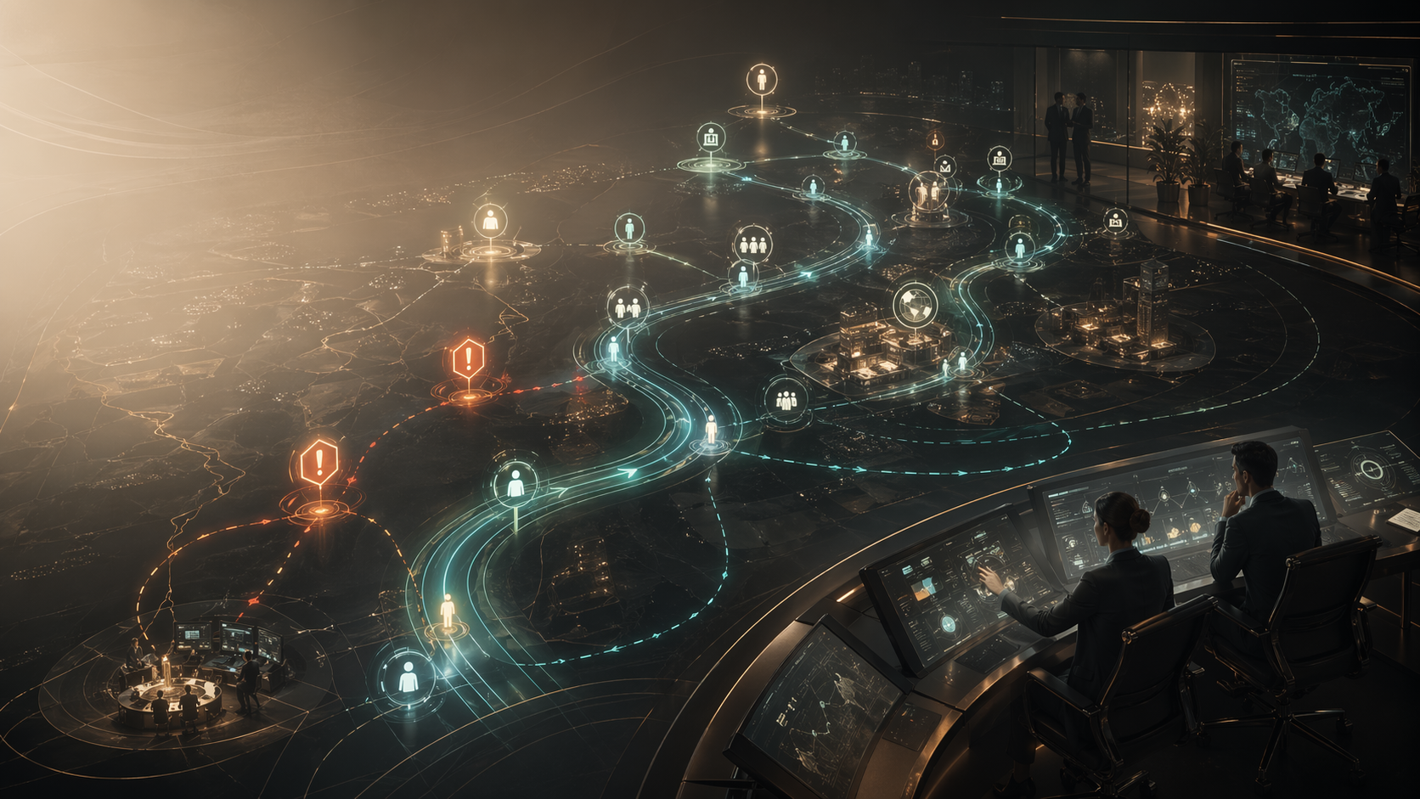
LIFECYCLE
05 / 07
Signed contract to productive employee
Onboarding should be one coordinated lifecycle run across payroll, IT, office, learning, compliance, and manager readiness.
Contract triggers onboarding
Parallel orchestration
Human only on blockers
The moment a contract is
signed, the right market and
role-specific onboarding
graph starts automatically.
Access, payroll, workplace,
equipment, learning, and
manager prompts move in
parallel instead of through
serial queues.
People Ops sees launch
health and intervenes only
on readiness, compliance, or
manager gaps that threaten
day one quality.
Notes:
Use this slide to show that contract creation is not the end of the workflow. The handoff into onboarding is where quality often breaks today.
[Sources]
- Conceptual north-star framing for the Flutter people workflow workshop.
- Interactive Flutter People OS prototype created in this workspace to illustrate channels, orchestration, and supervision.

Slide 6

GOVERNANCE
06 / 07
Control model for a federated, regulated group
Trust comes from explicit boundaries: local policy packs, confidence thresholds, and escalation design.
Local policy packs
Confidence thresholds
Escalation design
Every workflow resolves the
right market, entity,
employment type, and brand
rules before it acts.
The system explains why it
is acting and opens review
when certainty or impact
drops.
Intervention is deliberate:
sensitive employee issues,
contract exceptions, and
regulatory edge cases route
to the right human with the
full trail.
Notes:
Make the point that governance is the product. In Flutter's case, local regulation and federated brands make this non-negotiable.
[Sources]
- Flutter official site, Our Business: https://flutter.com/our-business/
- Conceptual north-star framing for the Flutter people workflow workshop.

Slide 7

ROADMAP
07 / 07
Roadmap to the north star
Move in sequence: knowledge copilots first, then orchestrated workflows, then a full people mission control layer.
Phase 1 | Ask and find
Phase 2 | Run the workflow
Phase 3 | Supervise the fleet
Unify policy, process, and
internal knowledge so
employees and managers can
ask one layer in natural
language.
Automate bounded flows for
recruiting, contracts,
onboarding, leave, mobility,
and manager requests.
Give HR, recruiting, and
shared services one command
surface to supervise agents,
SLAs, risk, and
interventions.
Notes:
Close by aligning on where Flutter should start, what it should centralize, and what must stay locally governed.
[Sources]
- Flutter official site, Our Business: https://flutter.com/our-business/
- Flutter official site, Hyderabad Global Capability Centre: https://careers.flutter.com/our-locations/hyderabad/
- Conceptual north-star framing for the Flutter people workflow workshop.
- Interactive Flutter People OS prototype created in this workspace to illustrate channels, orchestration, and supervision.

